Slide 1
Sustainability of Livestock and Poultry Production:
Life Cycle Principles and Research
Dr. Michael Overcash
May 2, 2007
Aguadilla Puerto Rico

Slide 2
Lessons Learned from Defining Sustainability
It is a broad
Point of Convergence is the Brundtland Definition
No Agreement at Any Detailed Operational Level
→ Verbal Truce
In This Environment, the Essential Need is to be Transparent and Clear in Your Definition

Slide 3
Actual Sustainability Project or Research
Two Characteristics Appear Mandatory
  Clear use of quantitative tools with a focus on establishing the net effect in a complex system
  Some attention to the technology interface with social and economic issues

Slide 4
Increase in Variability
Social & Economic Interfaces
Aggregated Single Indicator Model – such as Ecological Footprint Analysis
Multi-
Indicators of Impacts
Life Cycle Inventory Data
Major challenge at the engineering or science levels
Technology,
Field Measurements,
Innovation
Assembly of System – Defining Boundaries
Meta Analysis, such as Emergy
System Model Built by Iteration

Slide 5
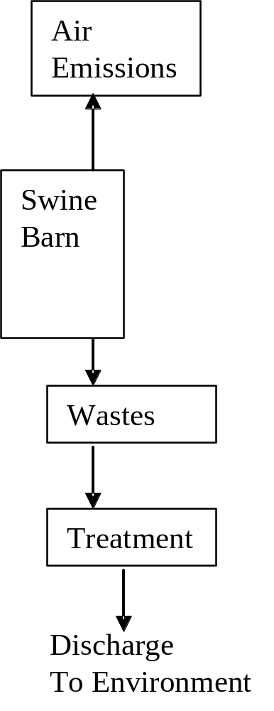
Typical System
For Swine
Production
This is one or two gate-to-gate lci

Slide 6
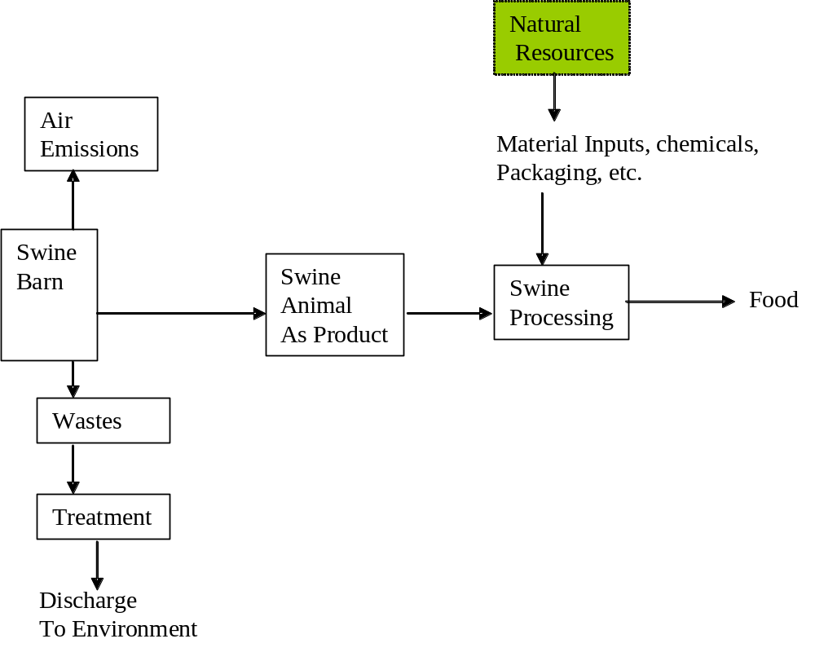

Slide 7
Natural
Resources
Non point Source
Discharge
To Environment
Soil
Productivity – A
Natural Resource
Air
Emissions
Material Inputs, chemicals,
Packaging, etc.
Water
Swine
Barn
Swine
Animal
As Product
Swine
Processing
Crops
Food
Agricultural
Chemicals
NPK
Fertilizer
Wastes
Treatment
Chemical
Supply
Chain
NPK
Manufacturing
Complex
Discharge
To Environment
Energy is Used in
Every System Shown Above
Petroleum
Extraction
As Natural
Resources
Natural
Resources
Natural
Resources
Electricity
Energy
Product
Discharge
To Environment

Slide 8
Natural
Resources
Non point Source
Discharge
To Environment
Soil
Productivity – A
Natural Resource
Air
Emissions
Material Inputs, chemicals,
Packaging, etc.
Water
Swine
Barn
Swine
Animal
As Product
Swine
Processing
Crops
Food
Agricultural
Chemicals
NPK
Fertilizer
Wastes
Treatment
Chemical
Supply
Chain
NPK
Manufacturing
Complex
Discharge
To Environment
Energy is Used in
Every System Shown Above
Petroleum
Extraction
As Natural
Resources
Natural
Resources
Natural
Resources
Electricity
Energy
Product
Discharge
To Environment

Slide 9
How Do Individual Projects & Researchers Contribute to the Systems Approach and Database?

Slide 10
FIVE GENERAL METHODS FOR LIFE CYCLE INVENTORY DATA
DIRECT MEASUREMENT FROM FACILITIES
CONSORTIA OF STAKEHOLDERS
ECONOMIC INPUT/OUTPUT
CHEMICAL ENGINEERING DESIGN METHOD
SOFTWARE DATABASES

Slide 11
LIFE CYCLE INVENTORY QUALITY
TRANSPARENCY
ENGINEERING PRINCIPLES OF MASS & ENERGY
LOGICAL MECHANISM TO CHANGE
EXPECTATIONS OF DECISION-MAKERS
CRITICAL RELATION OF SYSTEM TO SUSTAINABILITY FACTORS

Slide 12
Issues for Animal Waste Characterization
Major and universal input/output
Need agreed upon data for large numbers of parameters
State what waste characteristics are used in new technology evaluation
A major issue in sustainability is global climate change and for this carbon balances are vital. Currently TOC is very under-represented in the databases

Slide 13
Summary of data on swine waste nitrogen content from Barker and Overcash (2007)
 | Total waste | TKN in waste from barn | K in waste | P in waste
 | [kg total manure/1000kg LAW/day] | [g TKN/1000 kg LAW/day] | [g K/1000 kg LAW/day] | [g P/1000kg LAW/day]
Number of references | 79 | 45 | 38 | 39
Min | 16 | 195 | 91 | 70
Max | 175 | 842 | 533 | 300
Median | 86 | 449 | 299 | 144
Mean | 89 | 460 | 297 | 154
Standard deviation | 32 | 154 | 122 | 54

Slide 14
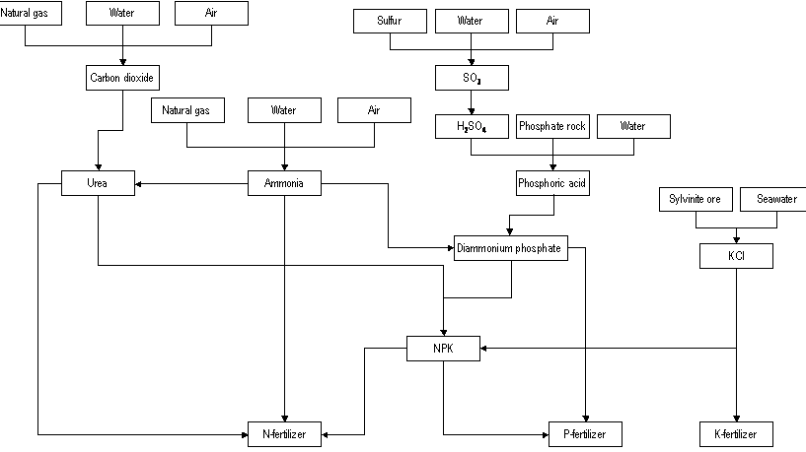

Slide 15
CO₂ emissions calculation for N in fertilizer.
 | NH3 | Urea | DAP | KCl | Total
Percentage of each source chemical that is N | 81.5 | 46.5 | 20.70
kg chemical used to make 1000 kg N in fertilizer | 650 | 798 | 478 | 0 | 1,926
kg N from chemical | 530 | 371 | 99 |  | 1,000
CO₂ cradle to gate (including transportation) [kg /1000kg chemical] | 661 | 1004 | 967 | 434
Allocation fraction | 1.00 | 1.00 | 0.475 | 1.00
Allocated CO₂ in each source (includes transport to mixing / manufacture of N fertilizer) [kg/1000 kg N] | 430 | 801 | 219 |  | 1,449.9
CO₂ from transportation of mixed fertilizer to distribution point [kg/1000 kg N in N fertilizer] | 56
Total CO₂ emissions to air [kg CO₂ / 1000 kg N in fertilizer] | 1,506

Slide 16
CO₂ emissions calculation for P₂O₅ in fertilizer.
 | Urea | DAP | KCl | Total
Percentage of P2O5 that comes from each chemical | - | 100 | -
kg chemical used to make 1000 kg of P₂O₅ in fertilizer | - | 1,880 | - | 1,880
kg chemical used to make 1000 kg of P in fertilizer | - | 4,305 | - | 4,305
CO₂ cradle to gate (including transportation) [kg /1000kg chemical] | 1,004 | 967 | 434
Allocation fraction |  | 0.525
Allocated CO₂ in each source (includes transport to mixing / manufacture of N fertilizer) [kg/1000 kg P₂O₅] |  | 955 |  | 955.2
CO₂ from transportation of mixed fertilizer to distribution point [kg/1000 kg P₂O₅ in P fertilizer] | - | 33 | - | 33
CO₂ from each source including transportation [kg/1000kg P in P fertilizer] | - | 988 | - | 988

Slide 17
CO₂ emissions calculation for K₂O in fertilizer.
 | KCl | Total
Percentage of K₂O that comes from each chemical | 100
kg chemical used to make 1000 kg of K₂O in fertilizer | 1,672 | 1,672
kg chemical used to make 1000 kg of K in fertilizer | 3,194 | 3,194
CO₂ in each source [kg/1000 kg chemical] | 434
Allocation Fraction | 1.00
Allocated CO₂ in each source including transportation to manufacture as K fertilizer [kg/1000 kg K₂O] | 726
CO₂ from transportation of KCl to distribution point [kg/1000 kg K₂O in K fertilizer] | 56 | 56
CO₂ in each source including transportation [kg / 1000 kg K in K fertilizer] | 782 | 107

Slide 18
Another Part of the Overall System is Animal Feed Production
There are 10 – 15 detailed life cycle inventories of different animal feed systems currently published
Evaluate these and settle on a reasonable lci feed profile
Decide what to use for this project.

Slide 19
Illustration of Life Cycle Thinking and Swine Waste Treatment Technologies
Current - lagoon/irrigation as fertilizer (including the sludge)
Ecokan
  aerobic/anaerobic system
  Reduces odor and ammonia losses
Covered lagoon
  Captures carbon as methane and carbon dioxide & burns for energy
  Reduces oil depletion impact
Direct land application

Slide 20
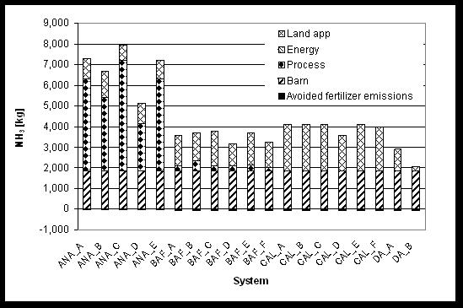
Anaerobic Lagoon
Spray Irrigation
Ekokan
Biofiltration
Covered Anaerobic
Lagoon/Spray Irrigation
Direct Land
Application

Slide 21
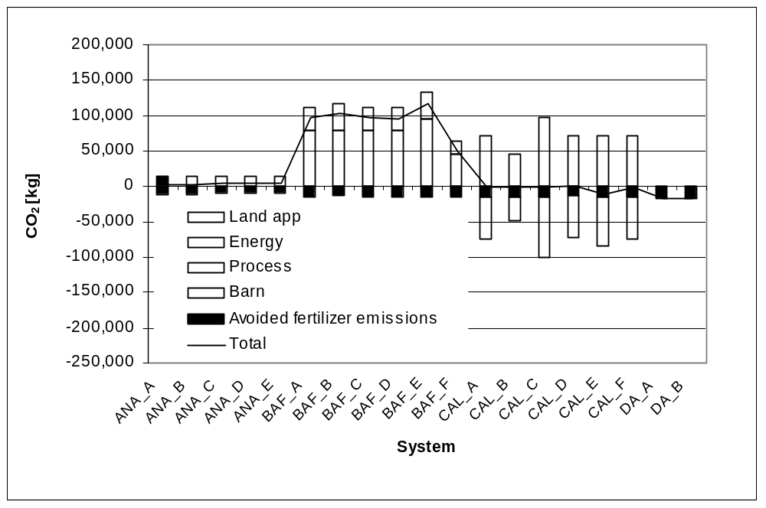
Anaerobic Lagoon
Spray Irrigation
Ekokan
Biofiltration
Covered Anaerobic
Lagoon/Spray Irrigation
Direct Land
Application

Slide 22
Control of emissions on-farm leads to
  a shift of emissions to other geographic areas (power plants versus farm)
  a shift and increase in different chemical emissions (global climate change versus odor)
  No value system is implied, just basic data on how the system changes

Slide 23
Observations on Economics
Cost data are important
Valuable if clearly linked to mass and energy comparisons, so that economic factors coincide with technical system
Interesting contrast with life cycle
  Environmental capital effects are almost always negligible
  Economic capital costs are generally significant

Slide 24
LIFE CYCLE SYSTEMS MODEL FOR THE OVERALL LIVESTOCK COMPLEX
With a format and each project results, the model will grow easily
Any change in parts of the system will affect the entire system
Start with very basic models to make sure it is working
Target to have the first tier model after one year

Slide 25
Lessons Learned in Sustainability Research
The sustainability model sill show the tradeoffs
  Shift in effects on different geographic locations
  Shift in types of chemical impacts on environment
  Shift in time across future domains
Net benefits will probably come by capturing most NPK while also getting carbon credit (true in both the feed part and the waste part of this complex system

Slide 26
Conclusions
The Livestock Sustainability Project is Very Timely
There are a Number of Life Cycle Parts of the Database that are Already Available
The Challenge is to Build Good Research Projects that Support the Systems Understanding Goals

